Slide 1
Constraining GPDs
Can we contribute with STAR

Slide 2
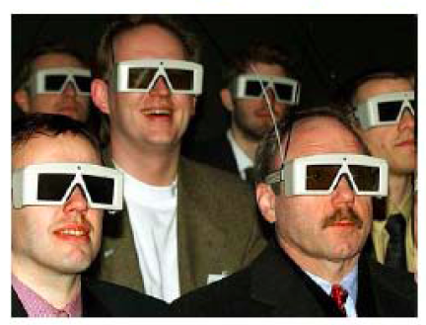
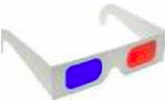
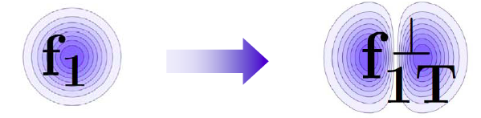
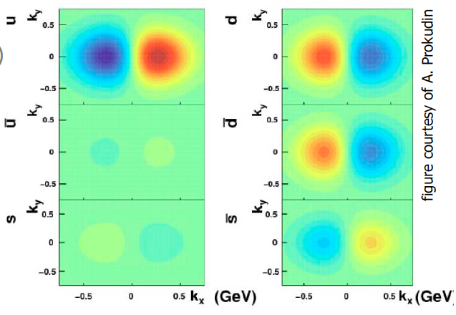
Quantum phase-space tomography of the nucleon
Wigner Distribution
W(x,r,k_{t})
Join the real
3D experience !!
TMDs
GPDs
3D picture in momentum space 3D picture in coordinate space
  transverse momentum generalized parton distributions
  dependent distributions → exclusive reaction like DVCS
Quarks
unpolarised polarised

Slide 3
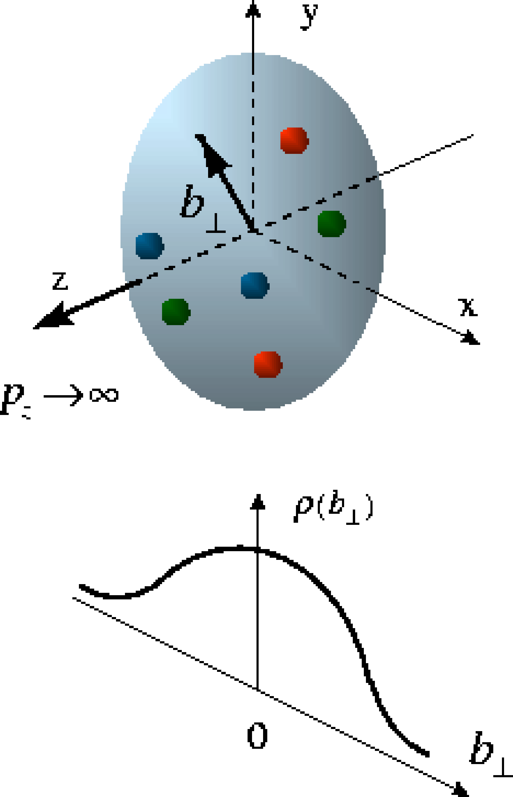
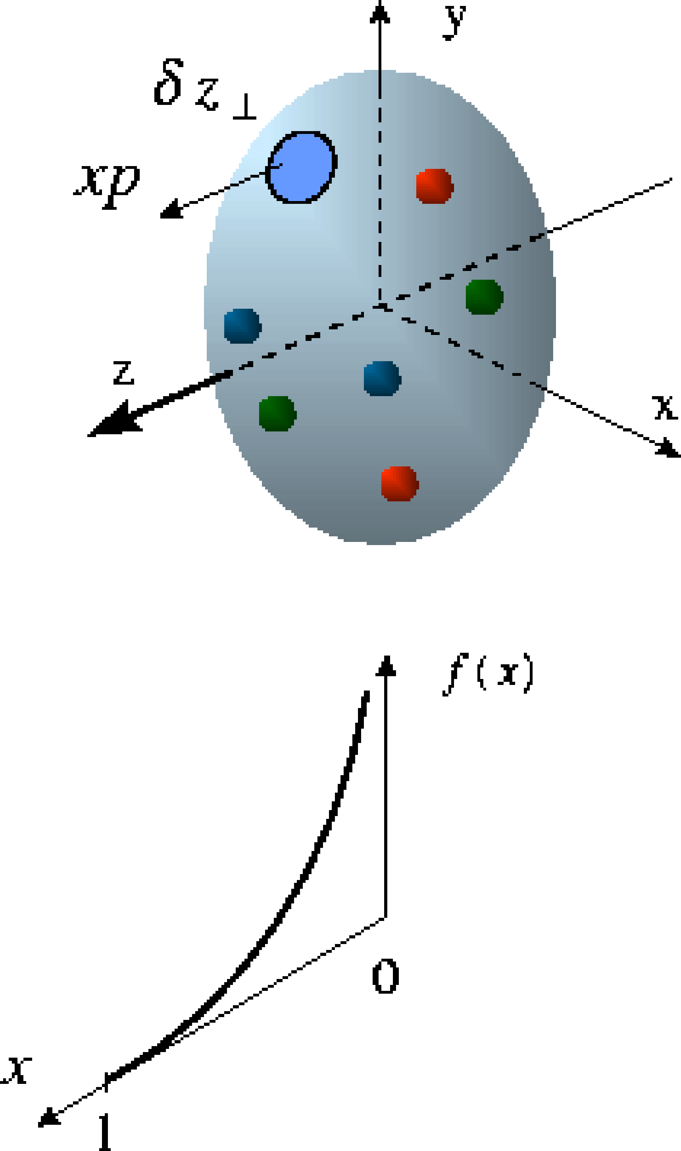
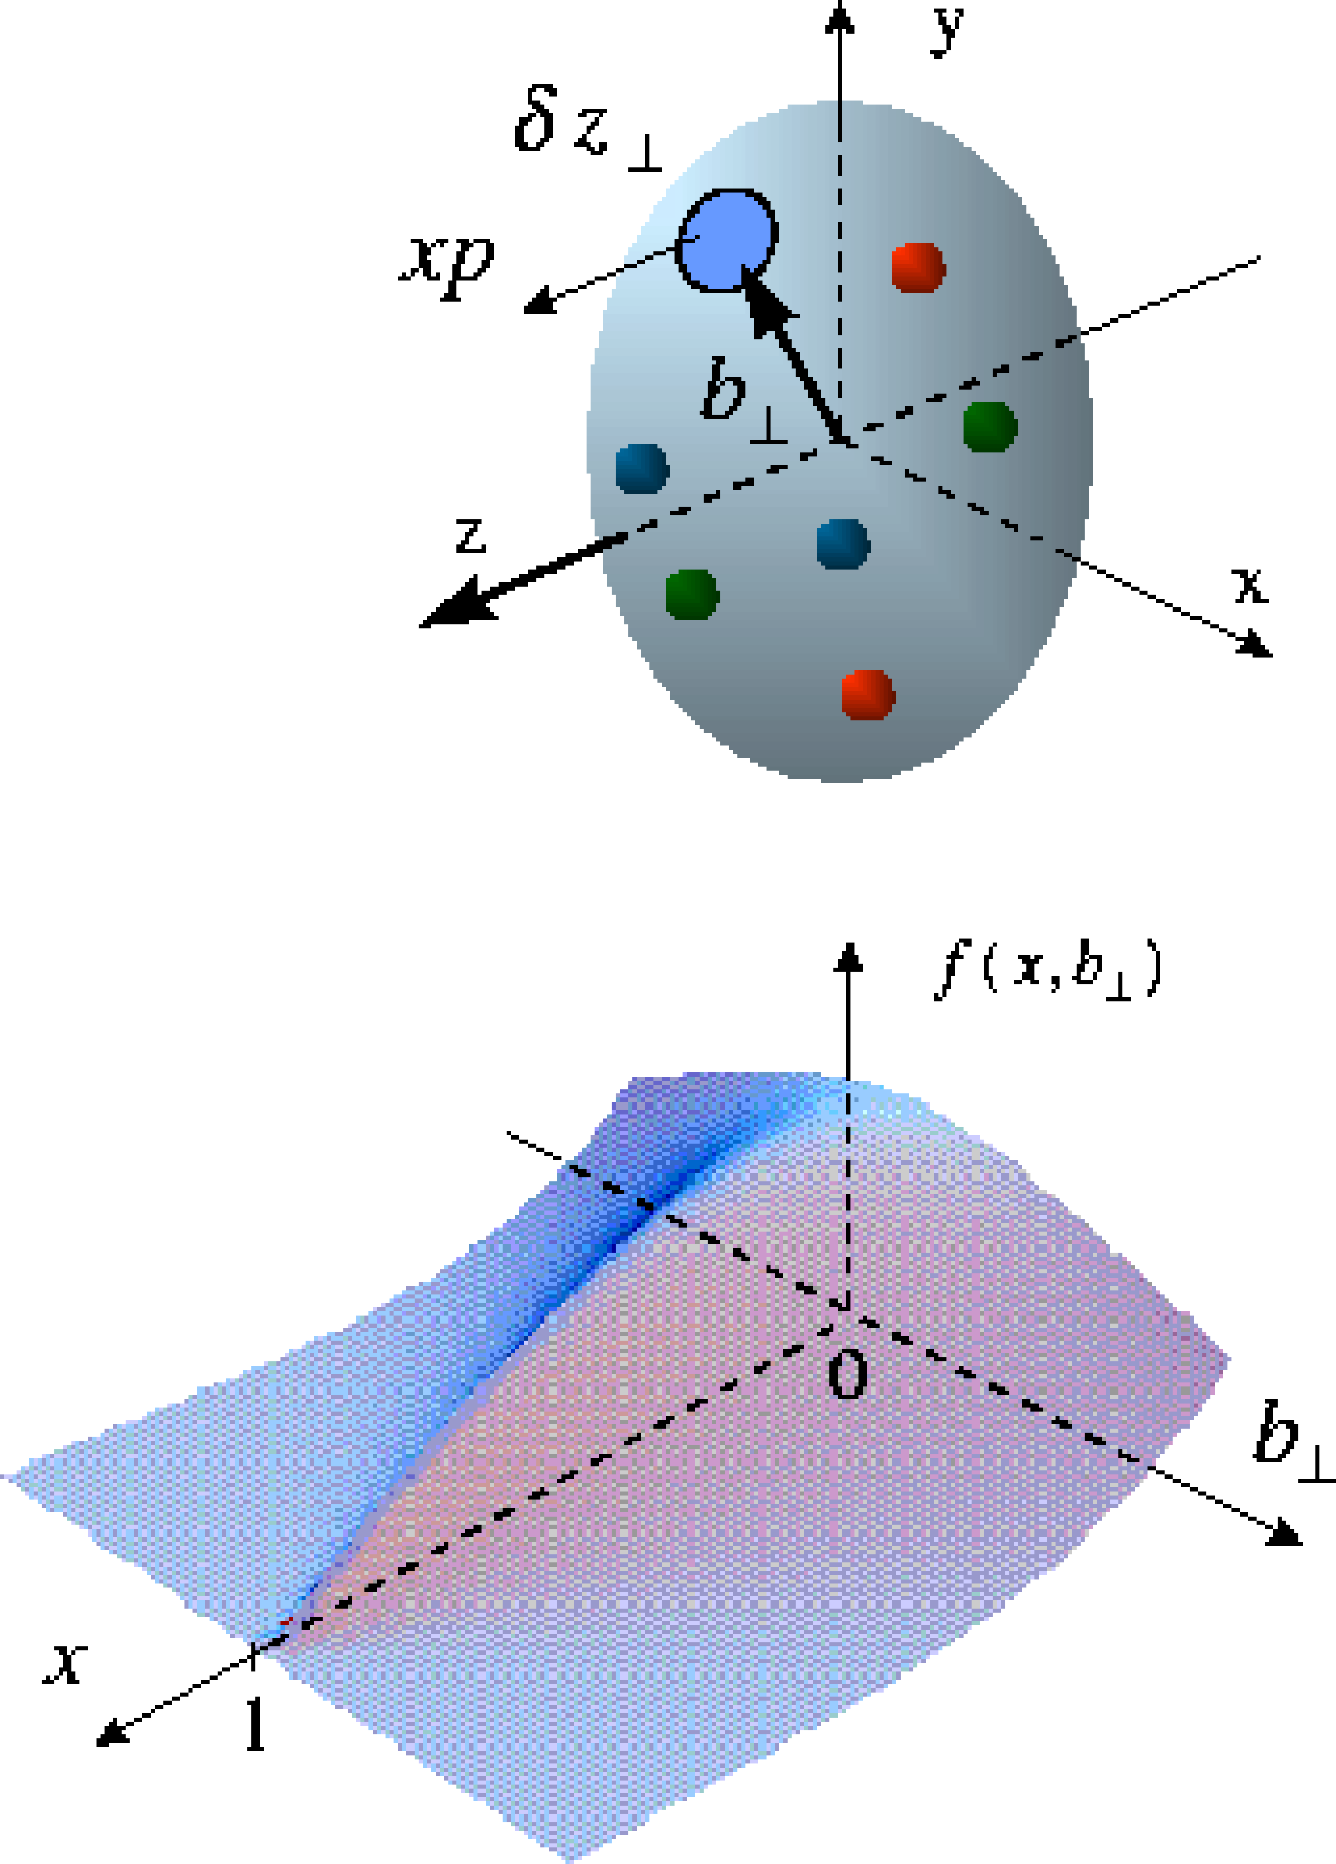
Beyond form factors and quark distributions
Generalized Parton Distributions
X. Ji, D. Mueller, A. Radyushkin (1994-1997)
Proton form factors, transverse charge & current densities
Structure functions,
quark longitudinal
momentum & helicity
distributions
Correlated quark momentum
and helicity distributions in
transverse space - GPDs

Slide 4
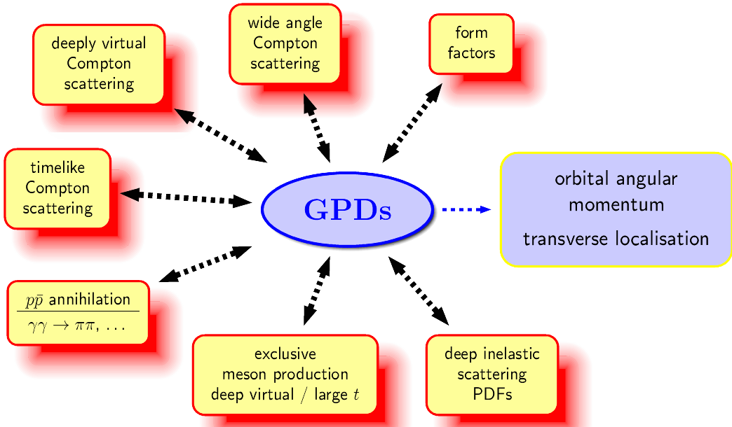
The Hunt for Lq
Study of hard exclusive processes
allows to access
a new class of PDFs
Generalized Parton Distributions
possible way to access
orbital angular momentum
DIS: ~0.3
Spin Sum Rule in PRF:
exclusive:
all reaction products are detected
missing energy (ΔE) and
missing Mass (M_{x}) = 0

Slide 5
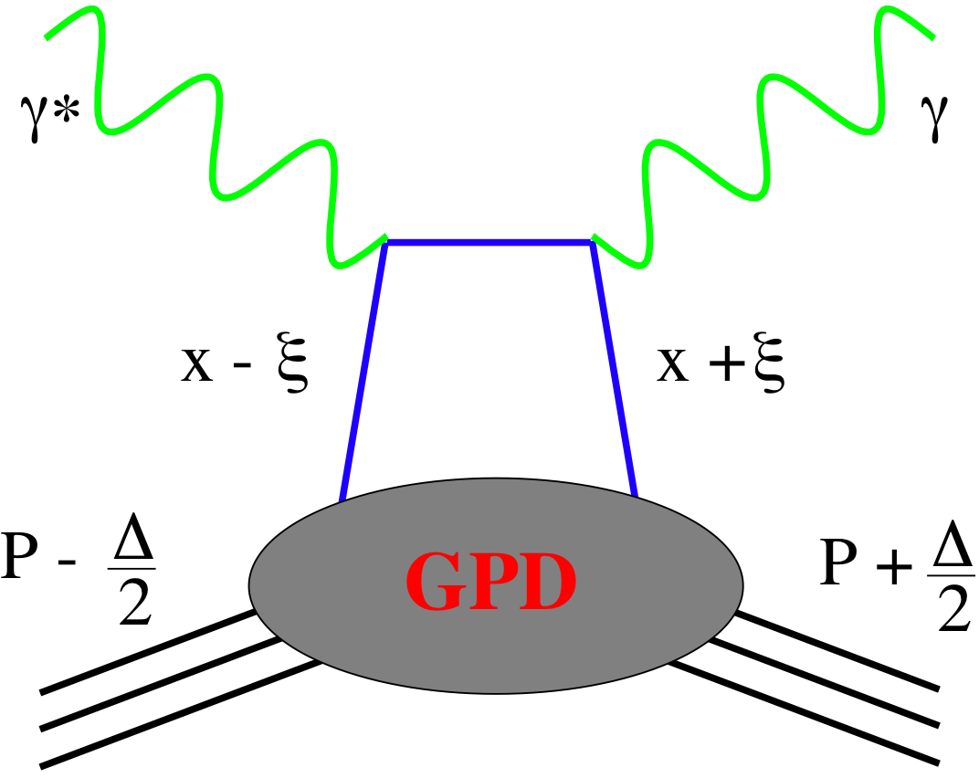
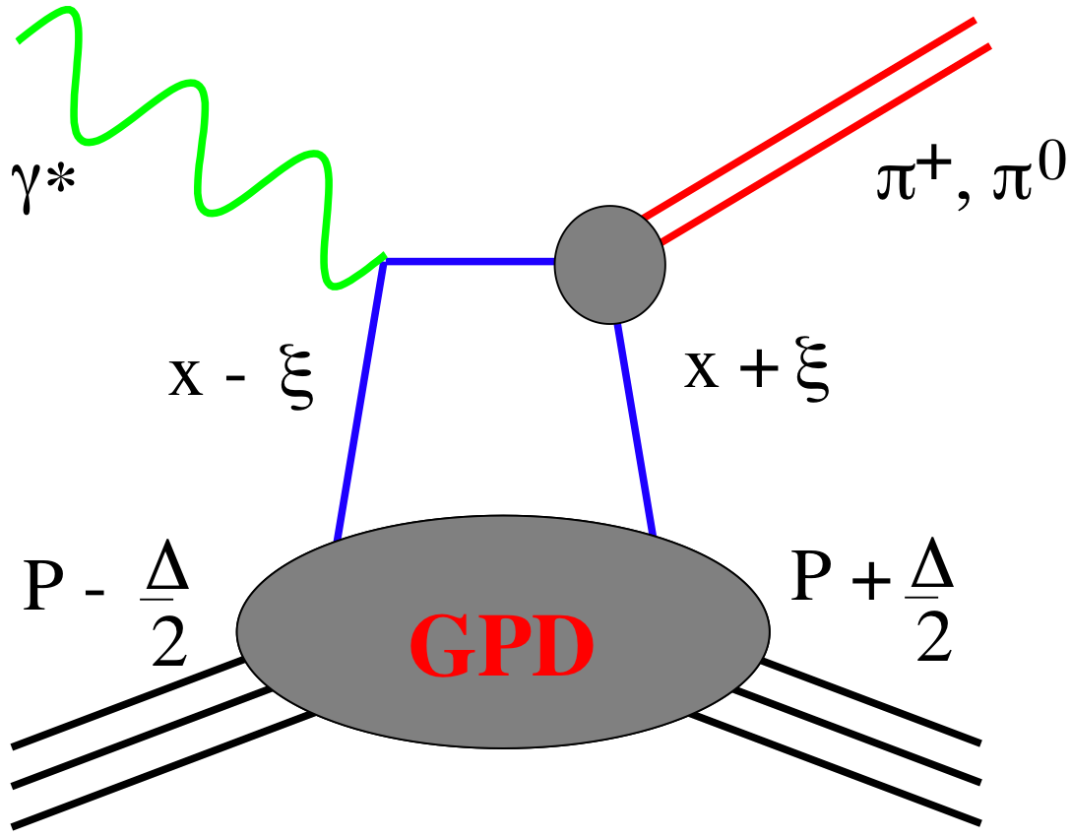
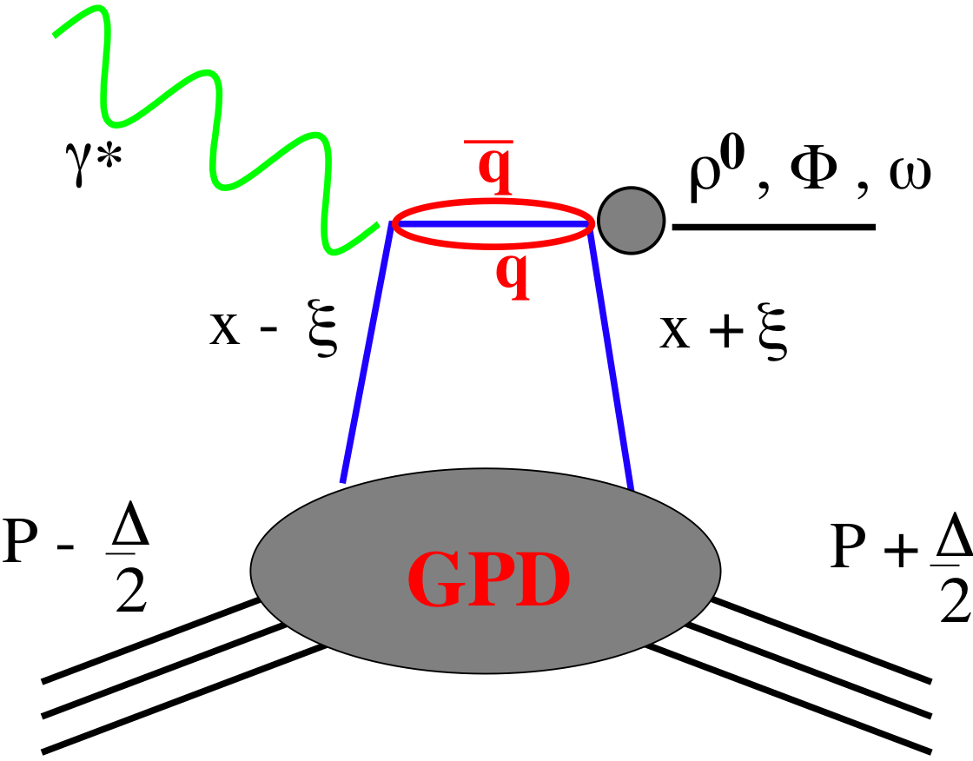
GPDs Introduction
How are GPDs characterized?
unpolarized polarized
conserve nucleon helicity
flip nucleon helicity
not accessible in DIS
quantum numbers of final state select different GPD
DVCS
pseudo-scaler mesons
vector mesons
π⁰ | 2Δu+Δd
η | 2Δu−Δd
ρ⁰ | 2u+d, 9g/4
ω | 2u−d, 3g/4
φ | s, g
ρ⁺ | u−d
J/ψ | g
Q²= 2E_{e}E_{e}’(1-cosθ_{e’})
x_{B} = Q²/2Mν ν=E_{e}-E_{e’}
x+ξ, x-ξ long. mom. fract.
t = (p-p’)²
ξ ≅ x_{B}/(2-x_{B})

Slide 6
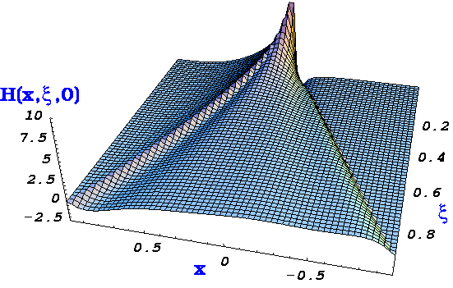
accessing GPDs: some caveats
but only ξ and t accessible experimentally
x is not acessible (integrated over):
apart from cross-over trajectory (x=ξ) GPDs not directly accessible:
deconvolution needed ! (model dependent)
GPD moments cannot be directly revealed,
extrapolations t → 0 are model dependent
t=0
q(x)
ξ=0 →
q(x)
cross sections & beam-charge asymmetry ~ Re(T ^{DVCS} )
beam or target-spin asymmetries ~ Im(T ^{DVCS} )

Slide 7
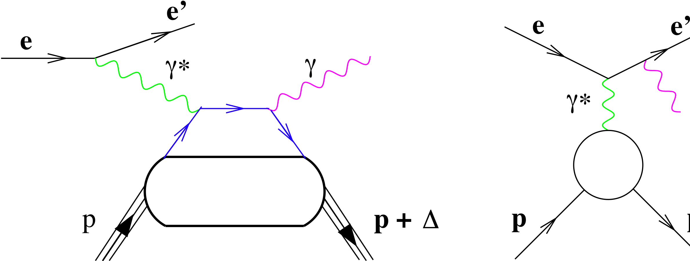
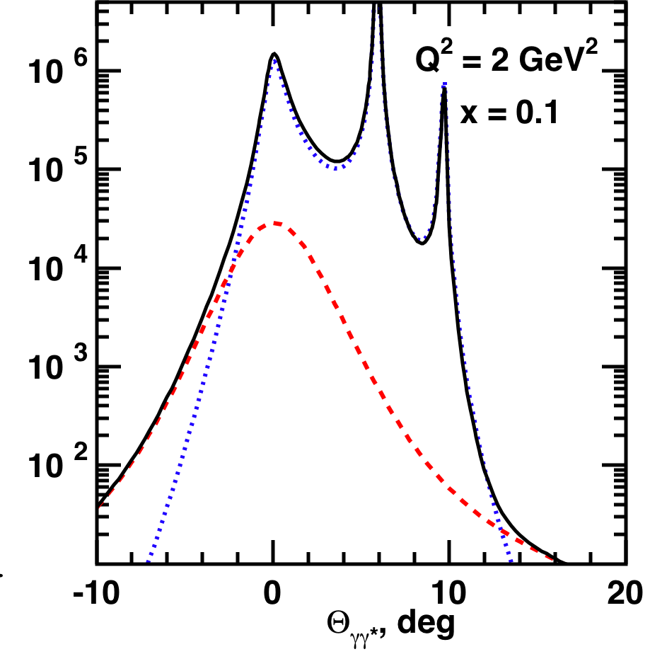


Deeply Virtual Compton Scattering: DVCS
most clean channel for interpretation in terms of GPDs
two experimentally undistinguishable processes:
HERMES / JLAB
kinematics: BH >> DVCS
p + Δ
DVCS
Bethe-Heitler (BH)
isolate BH-DVCS interference term non-zero azimuthal asymmetries
can measure DVCS – cross section and I

Slide 8
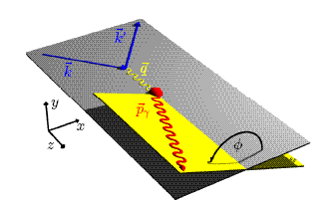
DVCS ASYMMETRIES
→ different charges: e⁺ e⁻:
~
Δσ_{C} ~ cosφ ∙Re{ H + ξH +… }
H
→ polarization observables:
~
Δσ_{LU} ~ sinφ∙Im{H + ξH + kE}
H
Δσ_{UT}
~
~
Δσ_{UL} ~ sinφ∙Im{H + ξH + …}
H
beam target
Δσ_{UT} ~ sinφ∙Im{k(H - E) + … }
H, E
ξ = x_{B}/(2-x_{B} ) k = t/4M²
kinematically suppressed

Slide 9
GPDs: DVCS@eRHIC
b=5.6
Specifications:
Statistical error down to 1%
It uses smeared t values (5% momentum resol.)
|t|-binning –> 3 * resolution (or higher)
5 X 100
(~ 10 months EIC)
S. Fazio

Slide 10
DVCS Asymmetries
Plots from D. Mueller

Slide 11
What will we learn about 2d+1 structure of the proton
GPD H and E as function of t, x and Q²
GPD H and E 1d+1
Plots from D. Mueller
GPD H and E 2d structure for quarks
A global fit over all mock data was done, based on the GPDs-based model:
[K. Kumerički, D Müller, K. Passek-Kumerički 2007]
Known values q(x), g(x) are assumed for H^{q}, H^{g} (at =0, t=0 forward limits E^{q}, E^{g} are unknown)
Excellent reconstruction of H^{sea}, H^{sea} and good reconstruction of H^{g} (from dσ/dt)

Slide 12
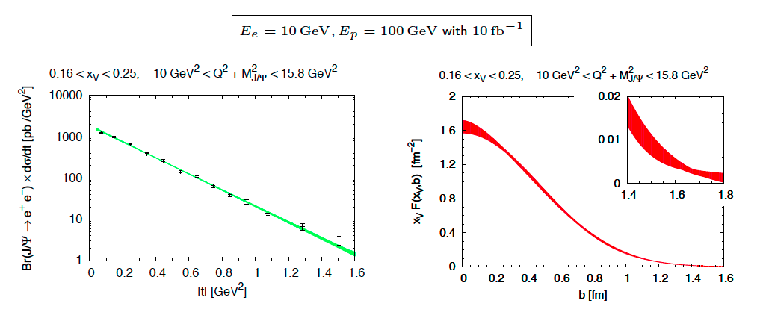
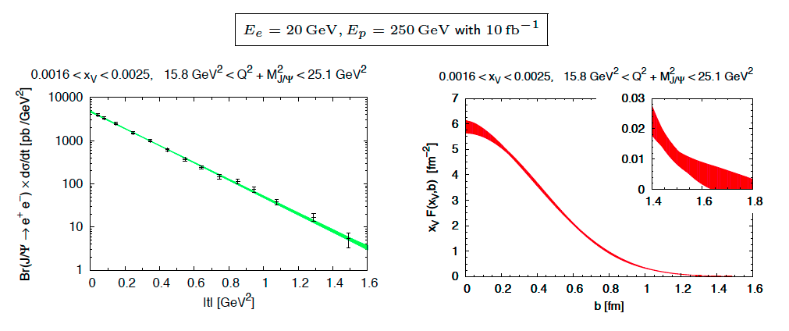
Other Channels: J/ψ
M. Diehl
J/ψ provides significant
improvement for H_{g}

Slide 13
EIC is GREAT
BUT
what can be done in polarized pp
NOW to constrain J_{g}

Slide 14
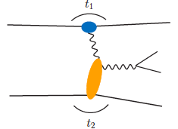
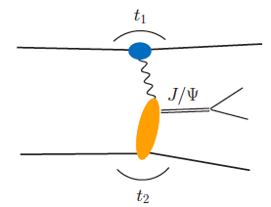
From pp to γp
Get quasi-real photon from one proton
Ensure dominance of g from one identified proton
by selecting very small t₁, while t₂ of “typical hadronic size”
small t₁ ←→ large impact parameter b (UPC)
Final state lepton pair ←→ timelike compton scattering
timelike Compton scattering: detailed access to GPDs
including E^{q;g} if have transv. target pol.
Challenging to suppress all backgrounds
Final state lepton pair not from γ* but from J/ψ
  Done already in AuAu
  Estimates for J/ψ (hep-ph/0310223)
transverse target spin asymmetry → calculable with GPDs
information on helicity-flip distribution E for gluons
golden measurement for eRHIC
Work in collaboration with Jakub Wagner, Dieter Mueller, Markus Diehl

Slide 15
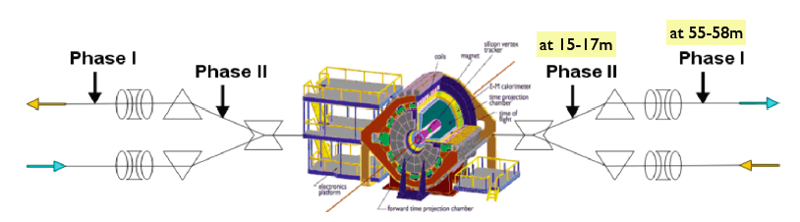
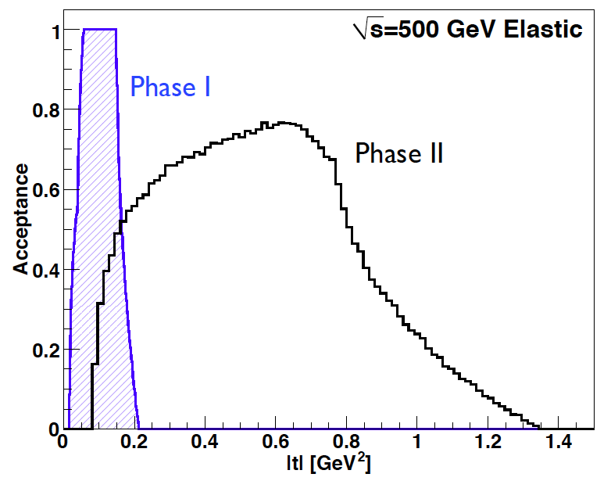
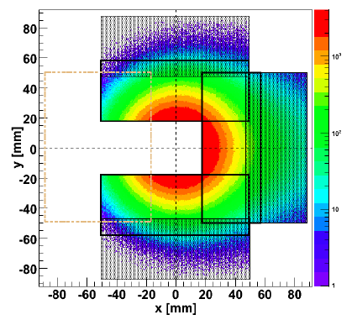
UPC in polarized pp collisions
STAR
J.H. Lee
Phase-I (installed): for low t-coverage
Phase-II (proposed): for high t-coverage
→ No special β* running needed any more

Slide 16
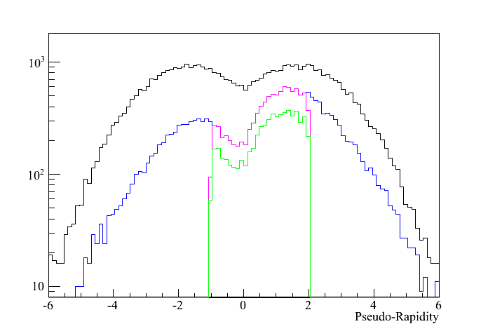
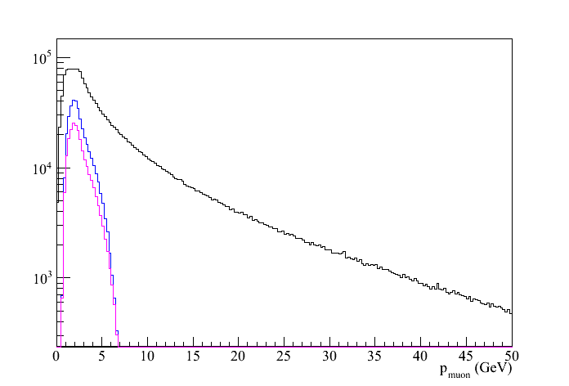
Decay μ kinematics
Muons without cuts
μ₁ and μ₂: -1 < η < 2
t<-0.1
Adding cut by cut:
Muons without cuts
μ₂: -1 < η < 2
μ₁ and μ₂: -1 < η < 2
t<-0.1
J/Ψ reconstructed through
e+e- and μ+μ- channels

Slide 17
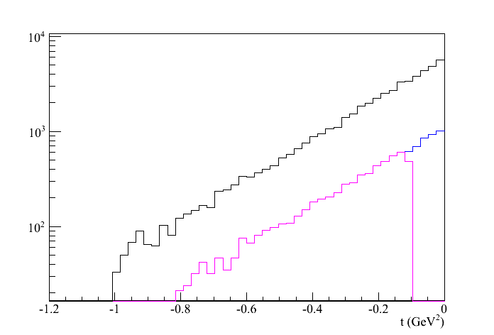
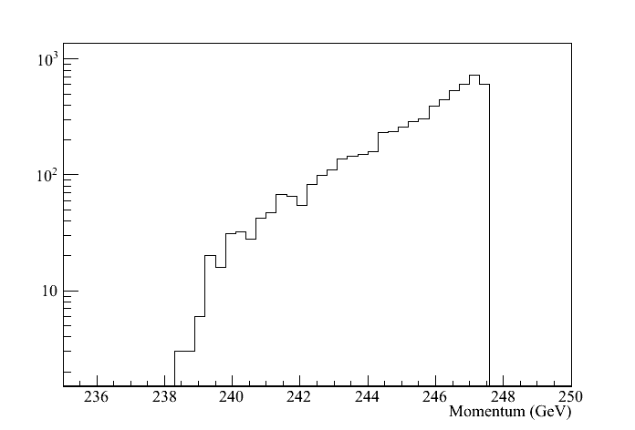
UPC kinematics
no cuts
μ₁ and μ₂: -1 < η < 2
t₂<-0.1
kinematics of proton-2
all cuts

Slide 18
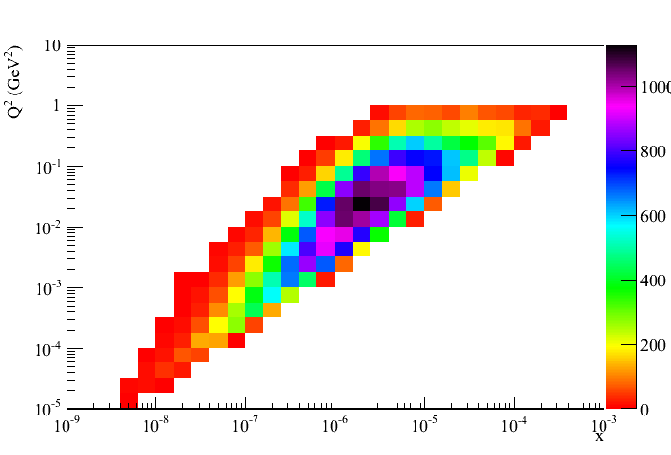
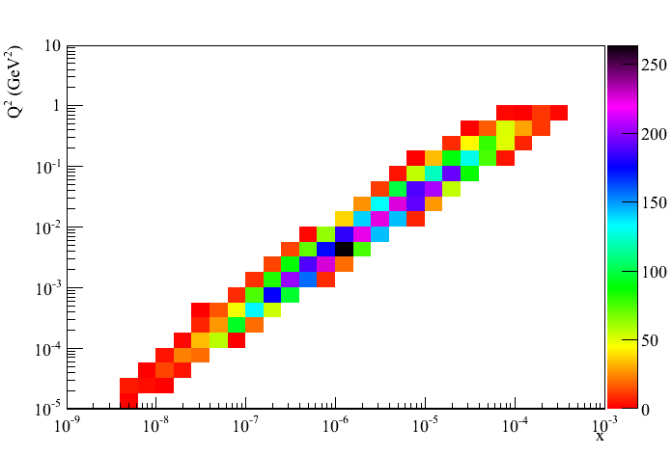
UPC kinematics
no cuts
all cuts

Slide 19
UPC: Outlook
Of course much more work needed
  cross section of 6.2nb @ 500 GeV (1.3nb @ 200GeV) is in agreement with theoretical calculations ☺
    2000 J/Ψ in 100 pb⁻¹
      need to account for branching ratio 12% → 240 J/Ψ ☹
  Open questions
    can we do the measurement via a rapidity gap method
      increased statistics t ~ p_{t}²(J/Ψ)
      can we use the FMS to see the J/psi → increased statistics
    optimize cuts to increase statistics and detect elastic proton
    study backgrounds via pythia
Alternative channel Φ production cross section 450 nb
  need to do simulations
  hard scale is needed Q²>1GeV²

Slide 20
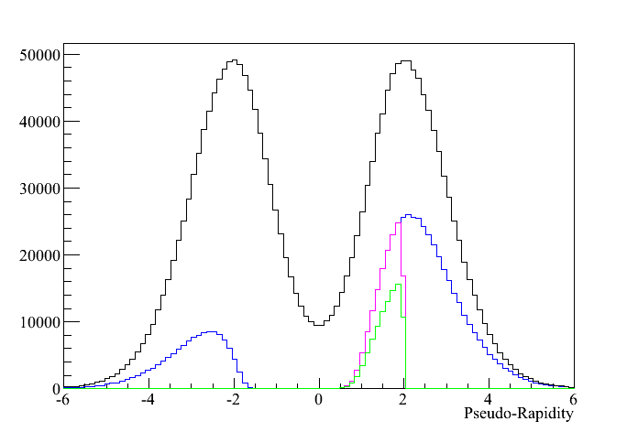
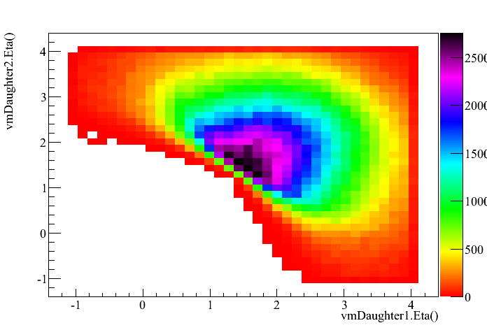
UPC: 200GeV
Adding cut by cut:
Muons without cuts
μ₂: -1 < η < 2
μ₁ and μ₂: -1 < η < 2
t<-0.1
600 J/Ψ in 100 pb⁻¹
in -1 < η < 2
1600 J/Ψ in 100 pb⁻¹
in -1 < η < 4

Slide 21
Summary
Need to study carefully what √s is will gives highest statistics at the lowest background
can we do something with Φs for Q² > 1 GeV²
Do simulations with including STAR and roman pots with full GEANT
If this all comes out reasonable lets think we can trigger efficiently
I think it is worthwhile to do this additional work
as it might give us
a measurement completely unique to RHIC

Slide 22
BACKUP

